Slide 1



EuroMesh
TUM AI Public Makers Hackathon 2025 - Digital Embassy
22.06.2025
Sebastian Ruffert, Raphael Hauser, Shu-Xiang Yang, Justin Lanfermann

Slide 2
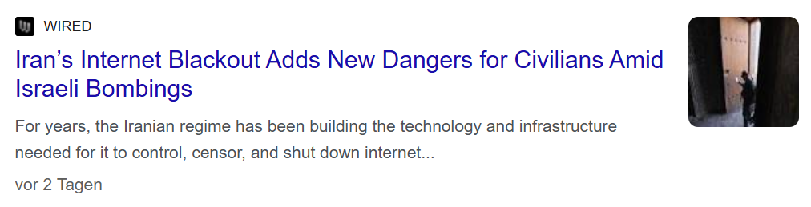
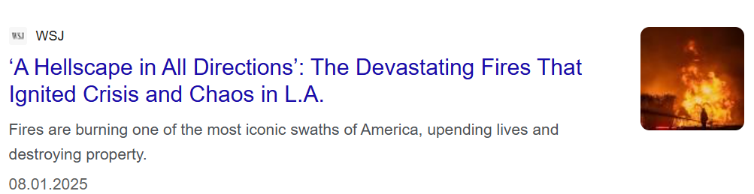
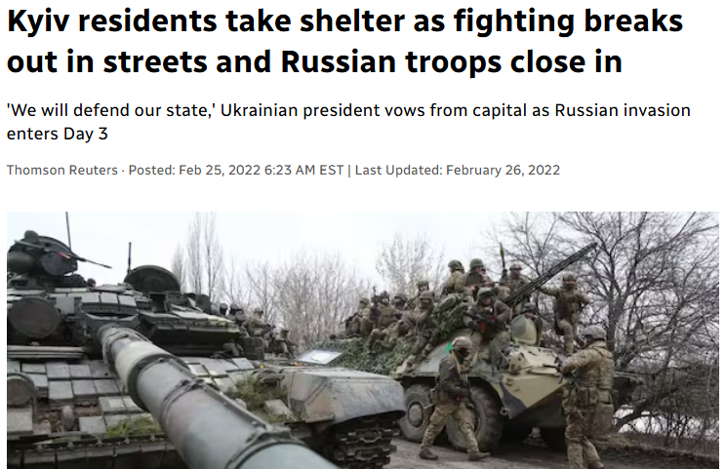
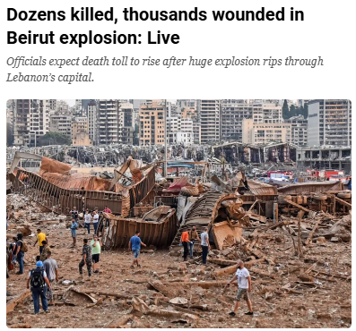
When Disaster Strikes, Information is Key
TUM AI Public Makers Hackathon 2025 - Digital Embassy
22.06.2025

Slide 3




Key Barriers to Civilian Safety in Crisis Situations
Lack of Situational Awareness
Isolation and Loss of Trust Networks
Information Overload and Misinformation
Restricted Access to Communication & Location Services
TUM AI Public Makers Hackathon 2025 - Digital Embassy
22.06.2025

Slide 4




Resilient Local Intelligence when Everything else Fails
Offline Evacuation and Aid Routing
Live, Crowd-Sourced Situational Updates
Trusted Local Activation via Authorities or NGOs
Offline Access to Critical Landmarks and Danger Zones
TUM AI Public Makers Hackathon 2025 - Digital Embassy
22.06.2025

Slide 5
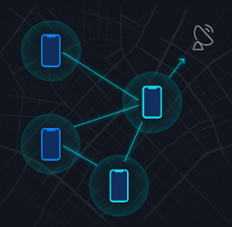






Emergency Bluetooth Mesh Network
Internet-Free, Citizen-Powered, Satellite-Connected
Presence Detection
Emergency Alerts
P2P Communication
Government Activated
EU-Passport Sign-Up
Data Sharing with EU Authorities
TUM AI Public Makers Hackathon 2025 - Digital Embassy
22.06.2025

